Slide 1
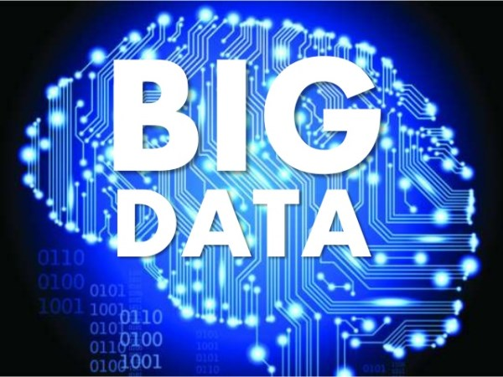

Slide 2
Course Objective
This course will cover the basic concepts of big data, methodologies for analyzing diversified data with emphasis on hands-on experience on tools and technologies to utilize in business decision making.

Slide 3
Course Outcomes
At the end of the course, students will be able to
1.Understand the concept, need and scope of Big Data.
2. Learn the handling of large volume and variety of data for future analysis.
3. Possess the skills necessary for utilizing tools like Hadoop and HDFS.
4. Apply the analytics on variety of applications using MapReduce and YARN.
5. Learn hands-on experience on various tools and technologies for decision making.

Slide 4
Text Books & Reference Books
1. Michael Minelli, Michelle Chambers, and Ambiga Dhiraj, "Big Data, Big Analytics: Emerging Business Intelligence and Analytic Trends for Today's Businesses", Wiley, 2013.
2. Big-Data Black Book, DT Editorial Services, Wily India
3. P. J. Sadalage and M. Fowler, "NoSQL Distilled: A Brief Guide to the Emerging World of Polyglot Persistence", Addison-Wesley Professional, 2012.
4. Tom White, "Hadoop: The Definitive Guide", Third Edition, O'Reilley,2012.
5. Eric Sammer, "Hadoop Operations", O'Reilley, 2012.
6. E. Capriolo, D. Wampler, and J. Rutherglen, "Programming Hive", O'Reilley,2012.
7. Lars George, "HBase: The Definitive Guide", O'Reilley, 2011.
8. Eben Hewitt, "Cassandra: The Definitive Guide", O'Reilley, 2010.
9. Alan Gates, "Programming Pig", O'Reilley, 2011.

Slide 5


Slide 6
Definition
Big data is a collection of large and complex data sets .
Not easy to handle and beyond system capability.
big data is the realization of greater business intelligence by storing, processing, and analyzing data.
previously ignored due to the limitations of traditional data management technologies.
Source: Harness the Power of Big Data: The IBM Big Data Platform

Slide 7
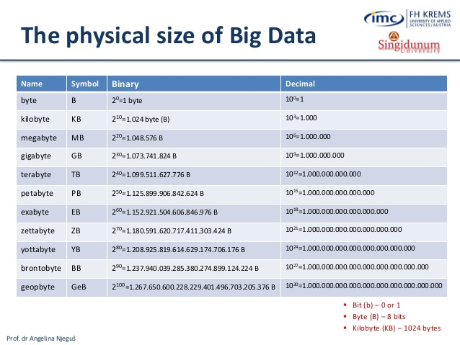

Slide 8
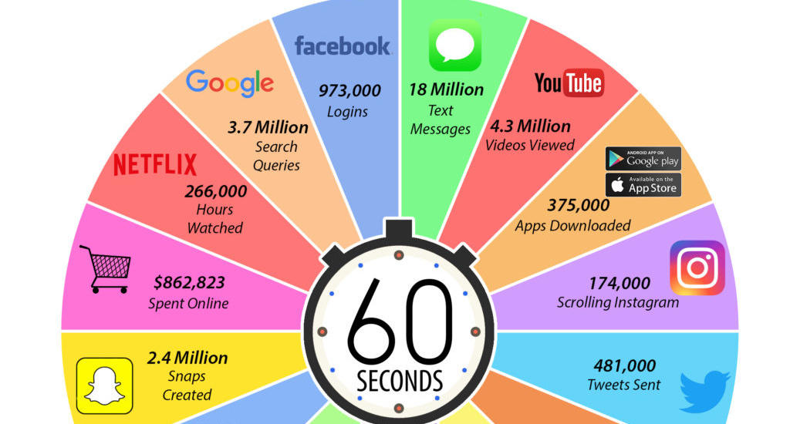

Slide 9
The four dimensions of Big Data
Volume: Large volumes of data
Velocity: Quickly moving data
Variety: structured, semi structured unstructured etc.
Veracity: Data uncertainty

Slide 10
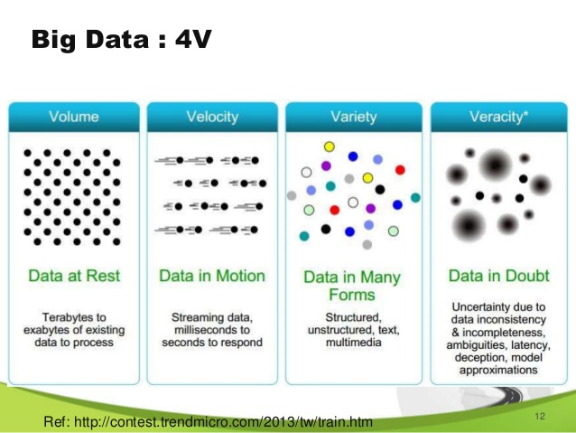

Slide 11



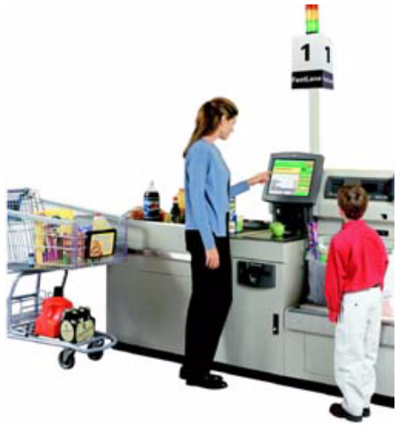
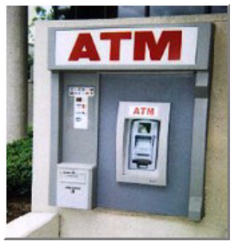
Source of Big Data!
  Major Domain Area
  Application Data
  System Data
  Machine Generated Data
  Biological Data/Genetic Data
  Web data, e-commerce
  purchases at department/grocery stores
  Bank, Credit Card transactions
  Social Network
  Sensors data
  Location based data
  satellite data
  RFID
  Real Time Data
  Spatial Data
  Etc

Slide 12
Requirement for Big Data
Huge Data Volumes Storage
Data Distribution
High-Performance Computing
Task and Thread Management
Data Mining and Analytics
Data Retrieval
Machine Learning
Data Visualization

Slide 13
What to do with these data?
Aggregation and Statistics
  Data warehouse and OLAP
Indexing, Searching, and Querying
  Keyword based search
  Pattern matching
  Knowledge prediction
- Known facts
Knowledge discovery
  Data Mining

Slide 14
Why Big data?
Understanding and Targeting Customers
Understanding and Optimizing Business Processes
Personal Quantification and Performance Optimization
Improving Healthcare and Public Health
Optimizing Machine and Device Performance
Improving Security and Law Enforcement.
Improving and Optimizing Cities and Countries
Financial Trading

